Slide 1

island:Zombified
A open world survival game by Leon and Tobi

Slide 2
Overview
General
Problems/Challenges
Solutions
Progress by each member
Finished status
Presentation of the Project

Slide 3
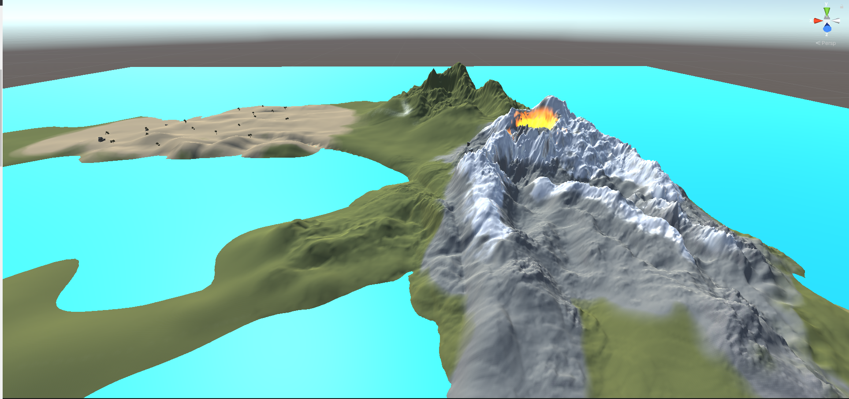
General
Open world Survival game
Combines the best aspects of Survival, Zombie Shooter and Open World (e.g. huge world to explore and Camp for Protection against Zombies)

Slide 4
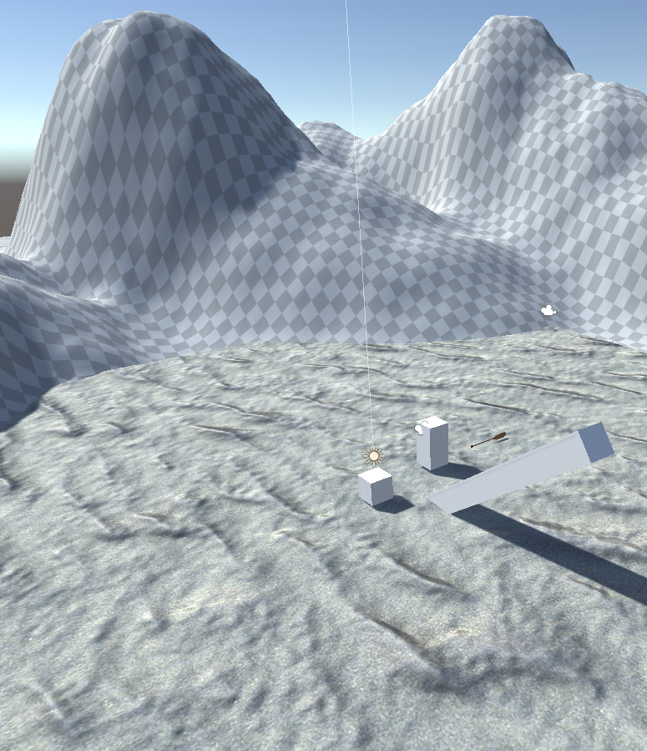
Problems/Challenges
Blender
Unity
Enemies didn‘t despawn

Slide 5

Solutions
Blender
Unity
Calculating a despawn range

Slide 6
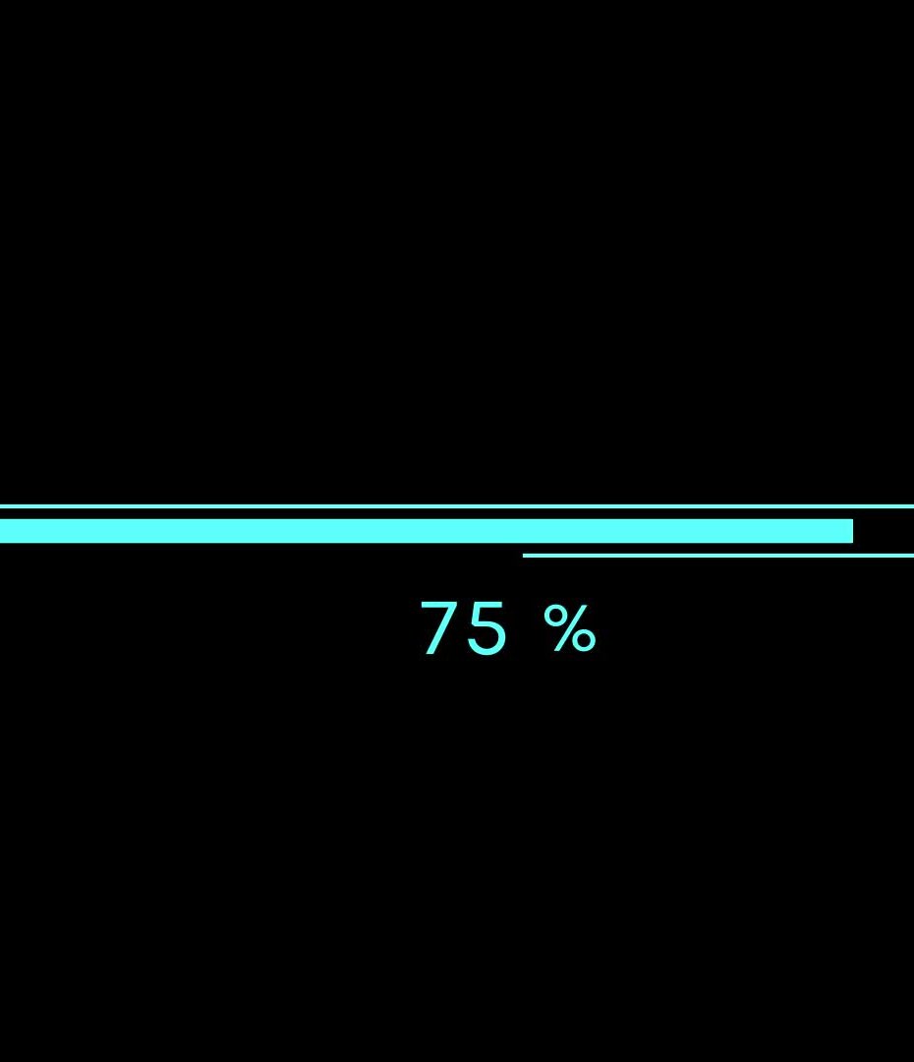
Progress
Blender
Unity
Enemy AI & Spawner
Animations
Switchable Views
Fixed Bugs

Slide 7

Finished Status
Small inventory with min. 4 weapons
Functional menu
Combat system

Slide 8
Presentation of Blender and Unity

Slide 9

Thanks for your attention!

Slide 10
Sources
http://datainfomobility.com/solutions/
https://www.dreamstime.com/illustration/finished-label.html

